Slide 1

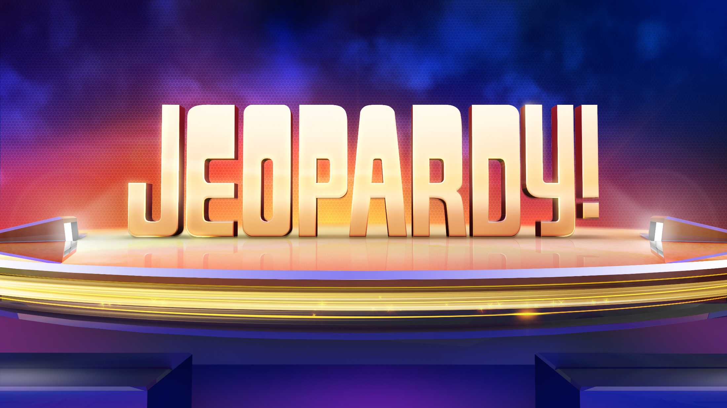

Slide 2
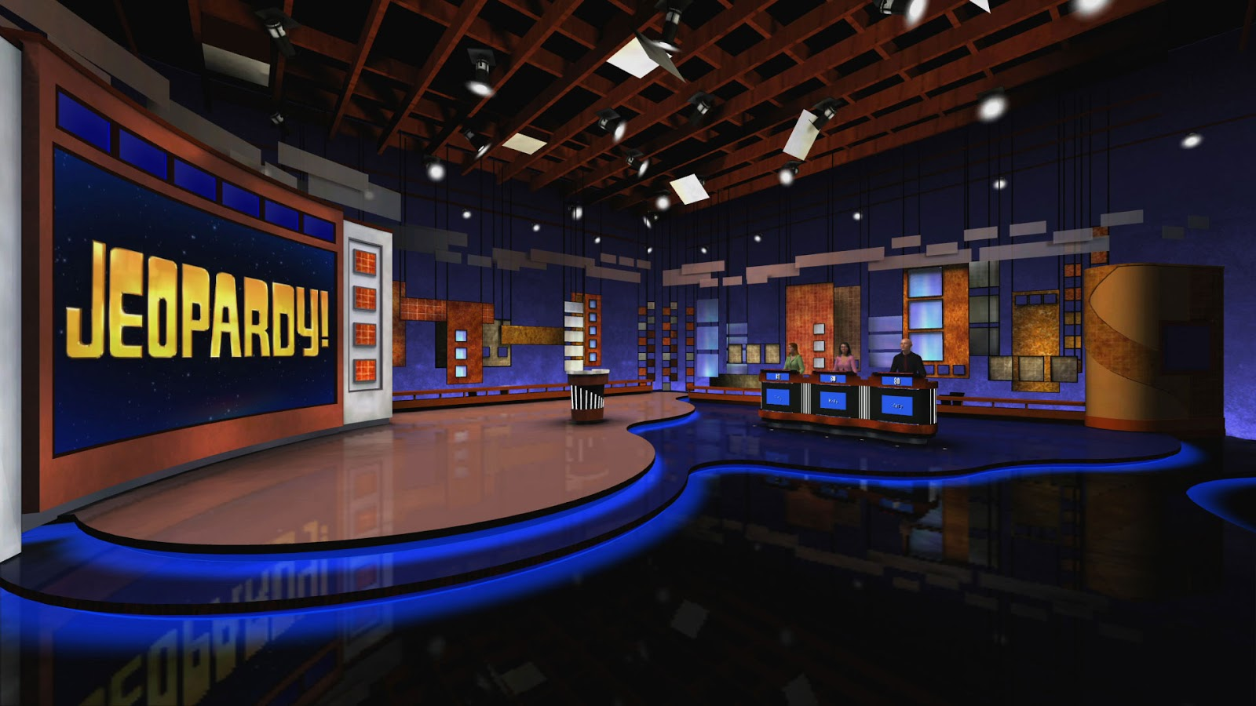

Slide 3
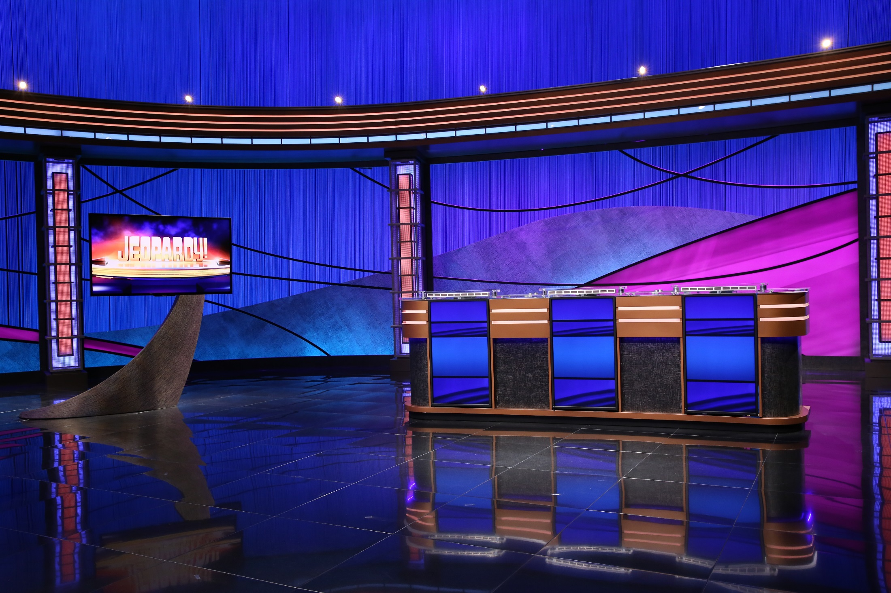
“Da rules of da game:”
1. All teams work in order.
2. When a team gives an incorrect answer, the other teams may “steal” the points by answering correctly without penalty for an incorrect answer.
0
3. Daily doubles have a limit of 5000 points.
4. Only the point person may answer a question they chose. HOWEVER, they may seek help from their group.
5. Highest score at the end wins.

Slide 4
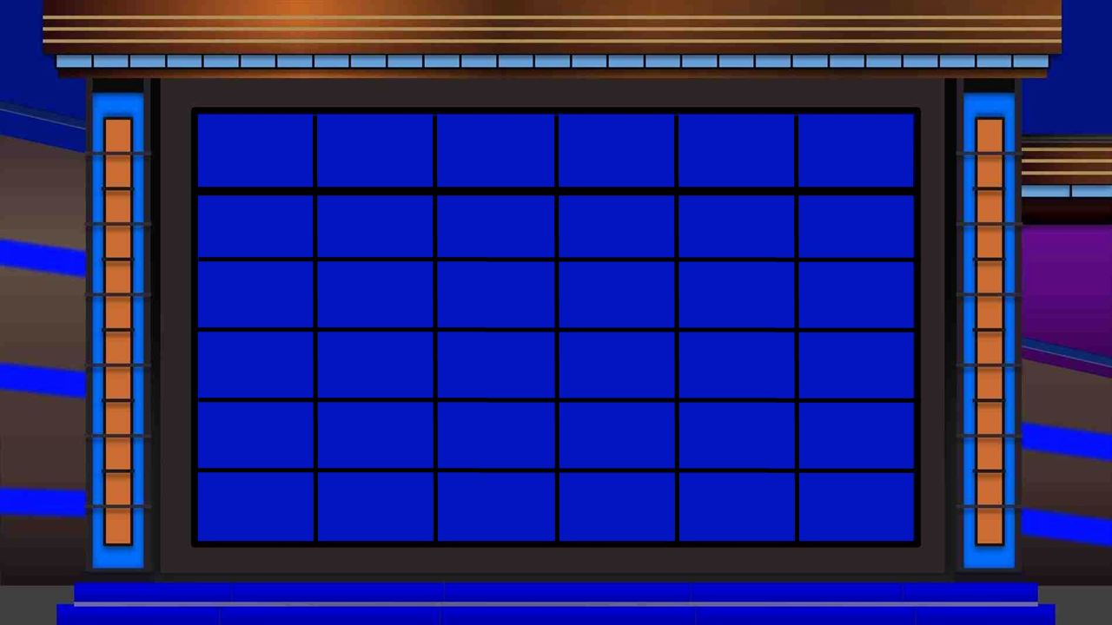

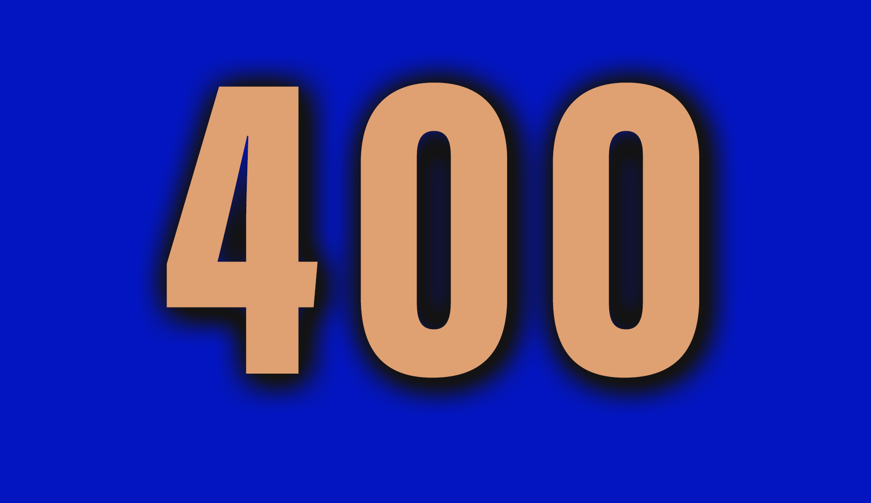
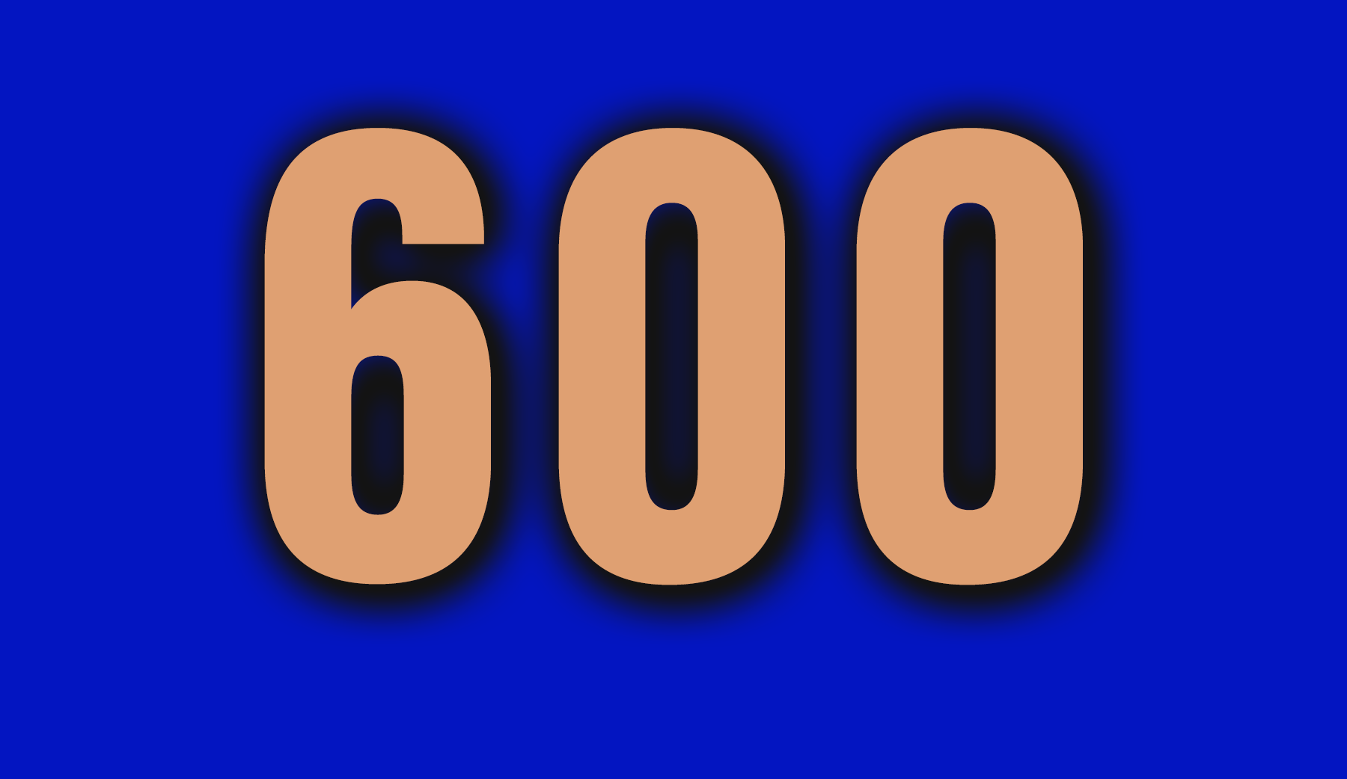
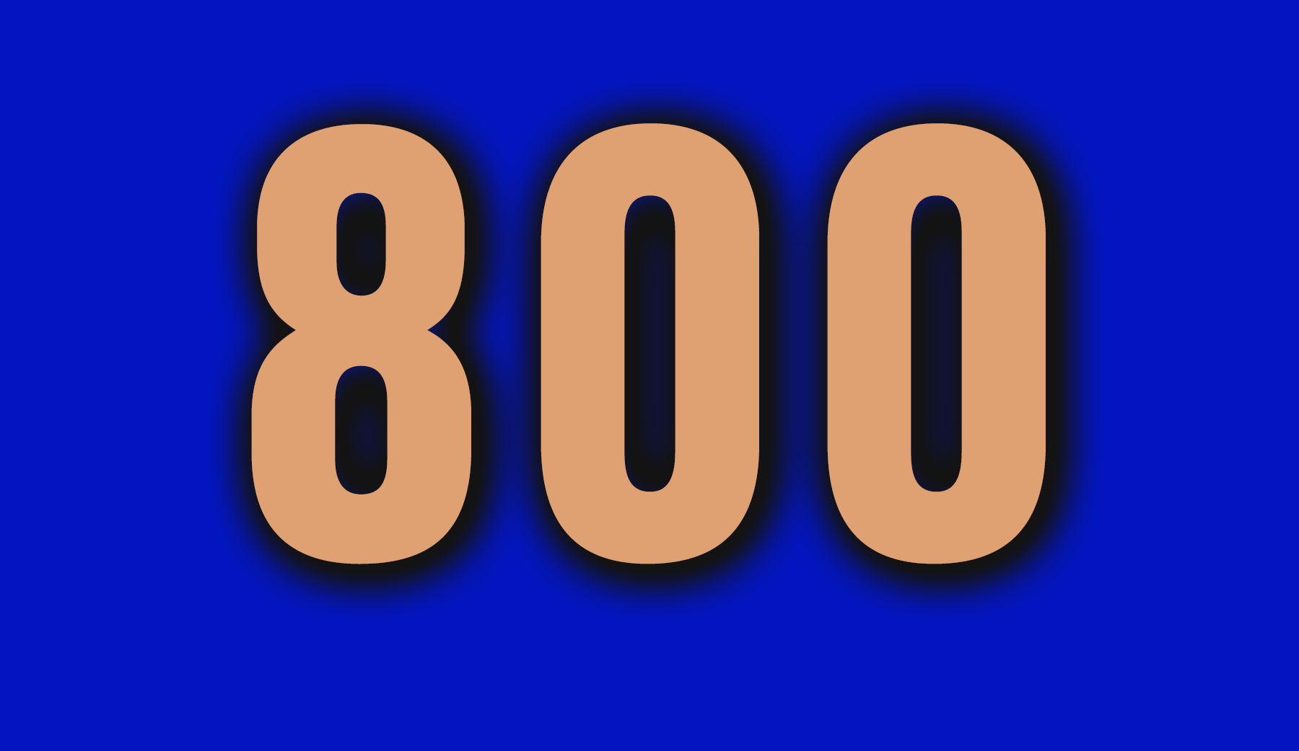
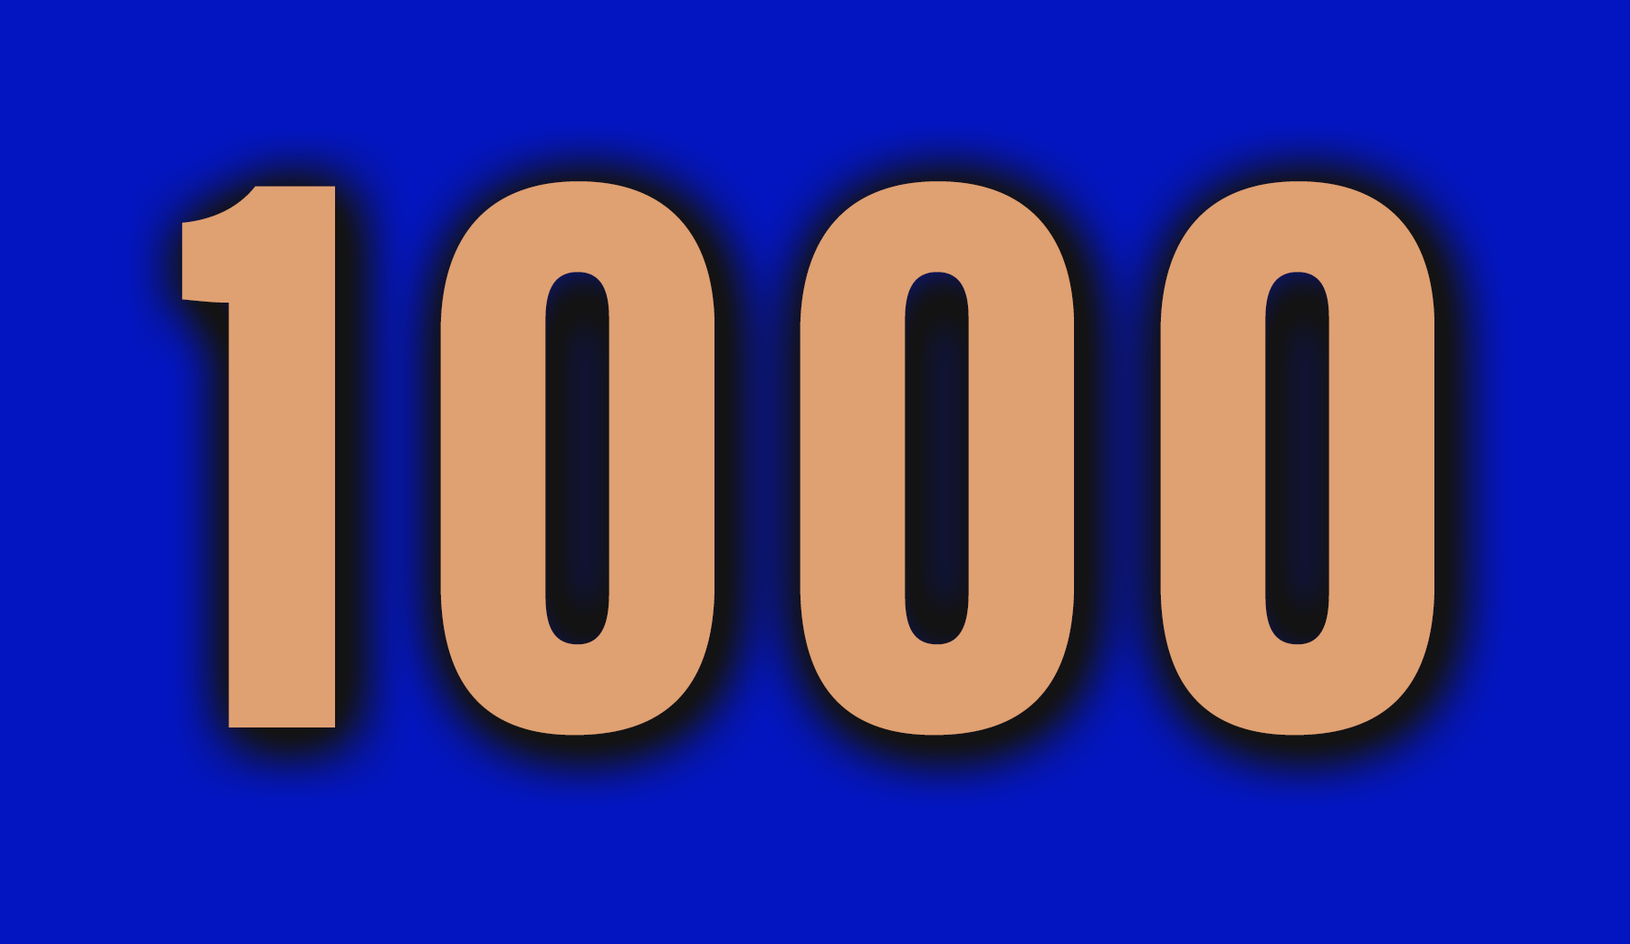
Rhythm
Musical Symbols
Navigation
Dynamics
The Staff
Time Signatures

Slide 5


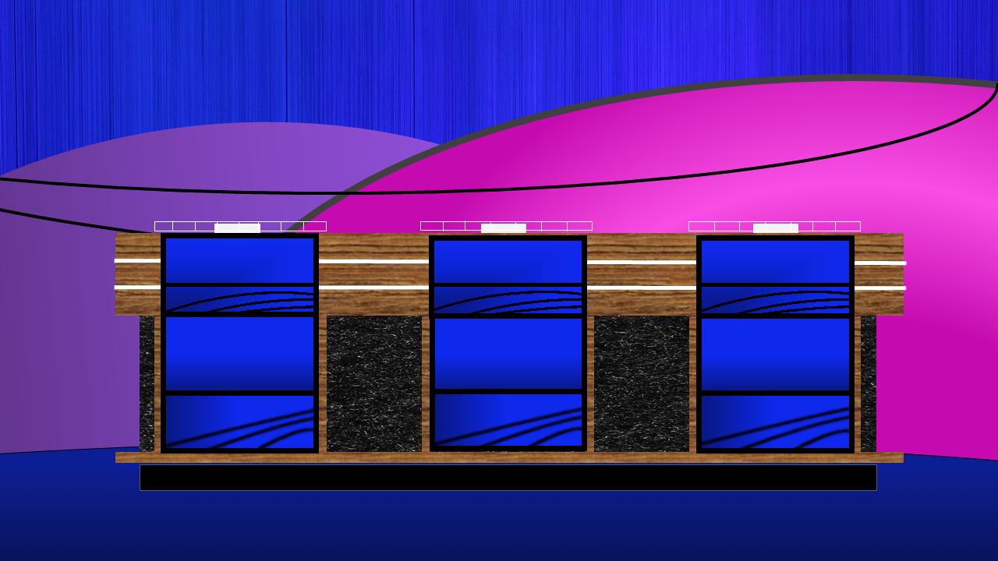
Rhythm
Musical Symbols
Navigation
Dynamics
The Staff
Time Signatures
Team 1
Team 2
Team 3

Slide 6

These notes are equal to one beat.

Slide 7
These are never in the shape of a circle. Certainly, you always work during them!

Slide 8
This is the only note that can change values.

Slide 9
The dotted half note equals this many beats.

Slide 10
These notes equal 1 beat when they are in groups of four.

Slide 11
This symbol means soft. Don’t be loud around a sleeping baby!

Slide 12
This symbol does not mean cheese but it is close. Instead, its name is Latin for hold.

Slide 13
This symbol tells players and singers where G is on the staff.

Slide 14
These symbols look like slurs, but actually tie two like notes together.

Slide 15
These symbols mean to play louder but for only the one note they are above or below.

Slide 16
These symbols tell the player or singer to play again. Usually only what is between them.

Slide 17
These brackets usually come at the end of phrases or sections.

Slide 18
These symbols indicate the end of sections or songs.

Slide 19
“D.C. al Fine” is usually used for which form of song.

Slide 20
In “D.S. al Coda,” The “S” stands for this Latin word.

Slide 21
This Latin word means “Loud.”

Slide 22
This symbol means to gradually get louder.

Slide 23
This is the Latin word for “medium.”

Slide 24
This symbol means “extra loud” or “very loud.”

Slide 25
When putting dynamics from softest to loudest, which symbol comes first: Mf or MP

Slide 26
This has 5 lines and four spaces.

Slide 27
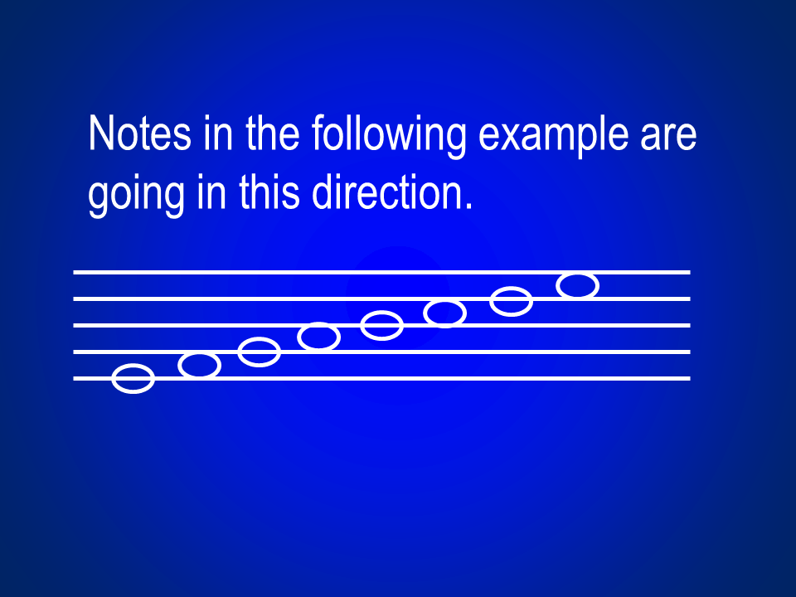

Slide 28
This symbol on the staff tells the performer how many beats to play per measure and what gets the beat.

Slide 29
These lines tell the performers when one measure ends and another begins.

Slide 30
We always count in this direction on the staff but don’t let talking dogs tell you .

Slide 31
This number in the time signature tells the performer how many beats per measure there are.

Slide 32
The bottom number in the time signature tells the performer this information.

Slide 33
This time signature has a letter and not numbers, but everyone knows that!

Slide 34
The top number in the time signature for a march is usually one of these two numbers.

Slide 35
You get these when the first measure does not equal what is in the time signature. You can check at the end.

Slide 36
Answer Bank

Slide 37
Quarter Note

Slide 38
Rests

Slide 39
Whole Note

Slide 40
Three Beats.

Slide 41
Sixteenth Notes

Slide 42
P for Piano

Slide 43
Fermata

Slide 44
G Clef or Treble Clef

Slide 45
Tie

Slide 46
Accent

Slide 47
Repeat Signs

Slide 48
First and Second Endings.

Slide 49
A-B-A or
A-A-B-A

Slide 50
Double Bars

Slide 51
Segno

Slide 52
Forte’

Slide 53
Crescendo

Slide 54
Mezzo

Slide 55
FF

Slide 56
MP

Slide 57
The Staff.

Slide 58
Ascending

Slide 59
Time Signature

Slide 60
Bar Lines

Slide 61
Up

Slide 62
The Top Number

Slide 63
What gets the beat in each measure.

Slide 64
Common Time

Slide 65
2 or 4

Slide 66
Pick Up Note or Anacrusis

Slide 67
Correlating slides Questions hyperlinked to Answers
Question Slide # Hyperlinked to answer slide
Column 1 Column 2 Column 3 Column 4 Column 5
6 hyper 37 11 hyper 42 16 hyper 47 21 hyper 52 26 hyper 57
7 hyper 38 12 hyper 43 17 hyper 48 22 hyper 53 27 hyper 58
8 hyper 39 13 hyper 44 18 hyper 49 23 hyper 54 28 hyper 59
9 hyper 40 14 hyper 45 19 hyper 50 24 hyper 55 29 hyper 60
10 hyper 41 15 hyper 46 20 hyper 51 25 hyper 56 31 hyper 61
Column 6: 31 hyper 62; 32 hyper 63; 33 hyper 64; 34 hyper 65; 35 hyper 66
* All answer slides hyperlink back to the game board which is slide #5.

